Slide 1
有文字的PPT只是作为提示切换时机的备份，实际上是隐藏的不会播放出来

Slide 2
背景和演戏时台上演员的布局是否一致要再看看，不对的话可以镜像/翻转

Slide 3
动画和细节之后再调整

Slide 4
Act 1. Scene 1

Slide 5
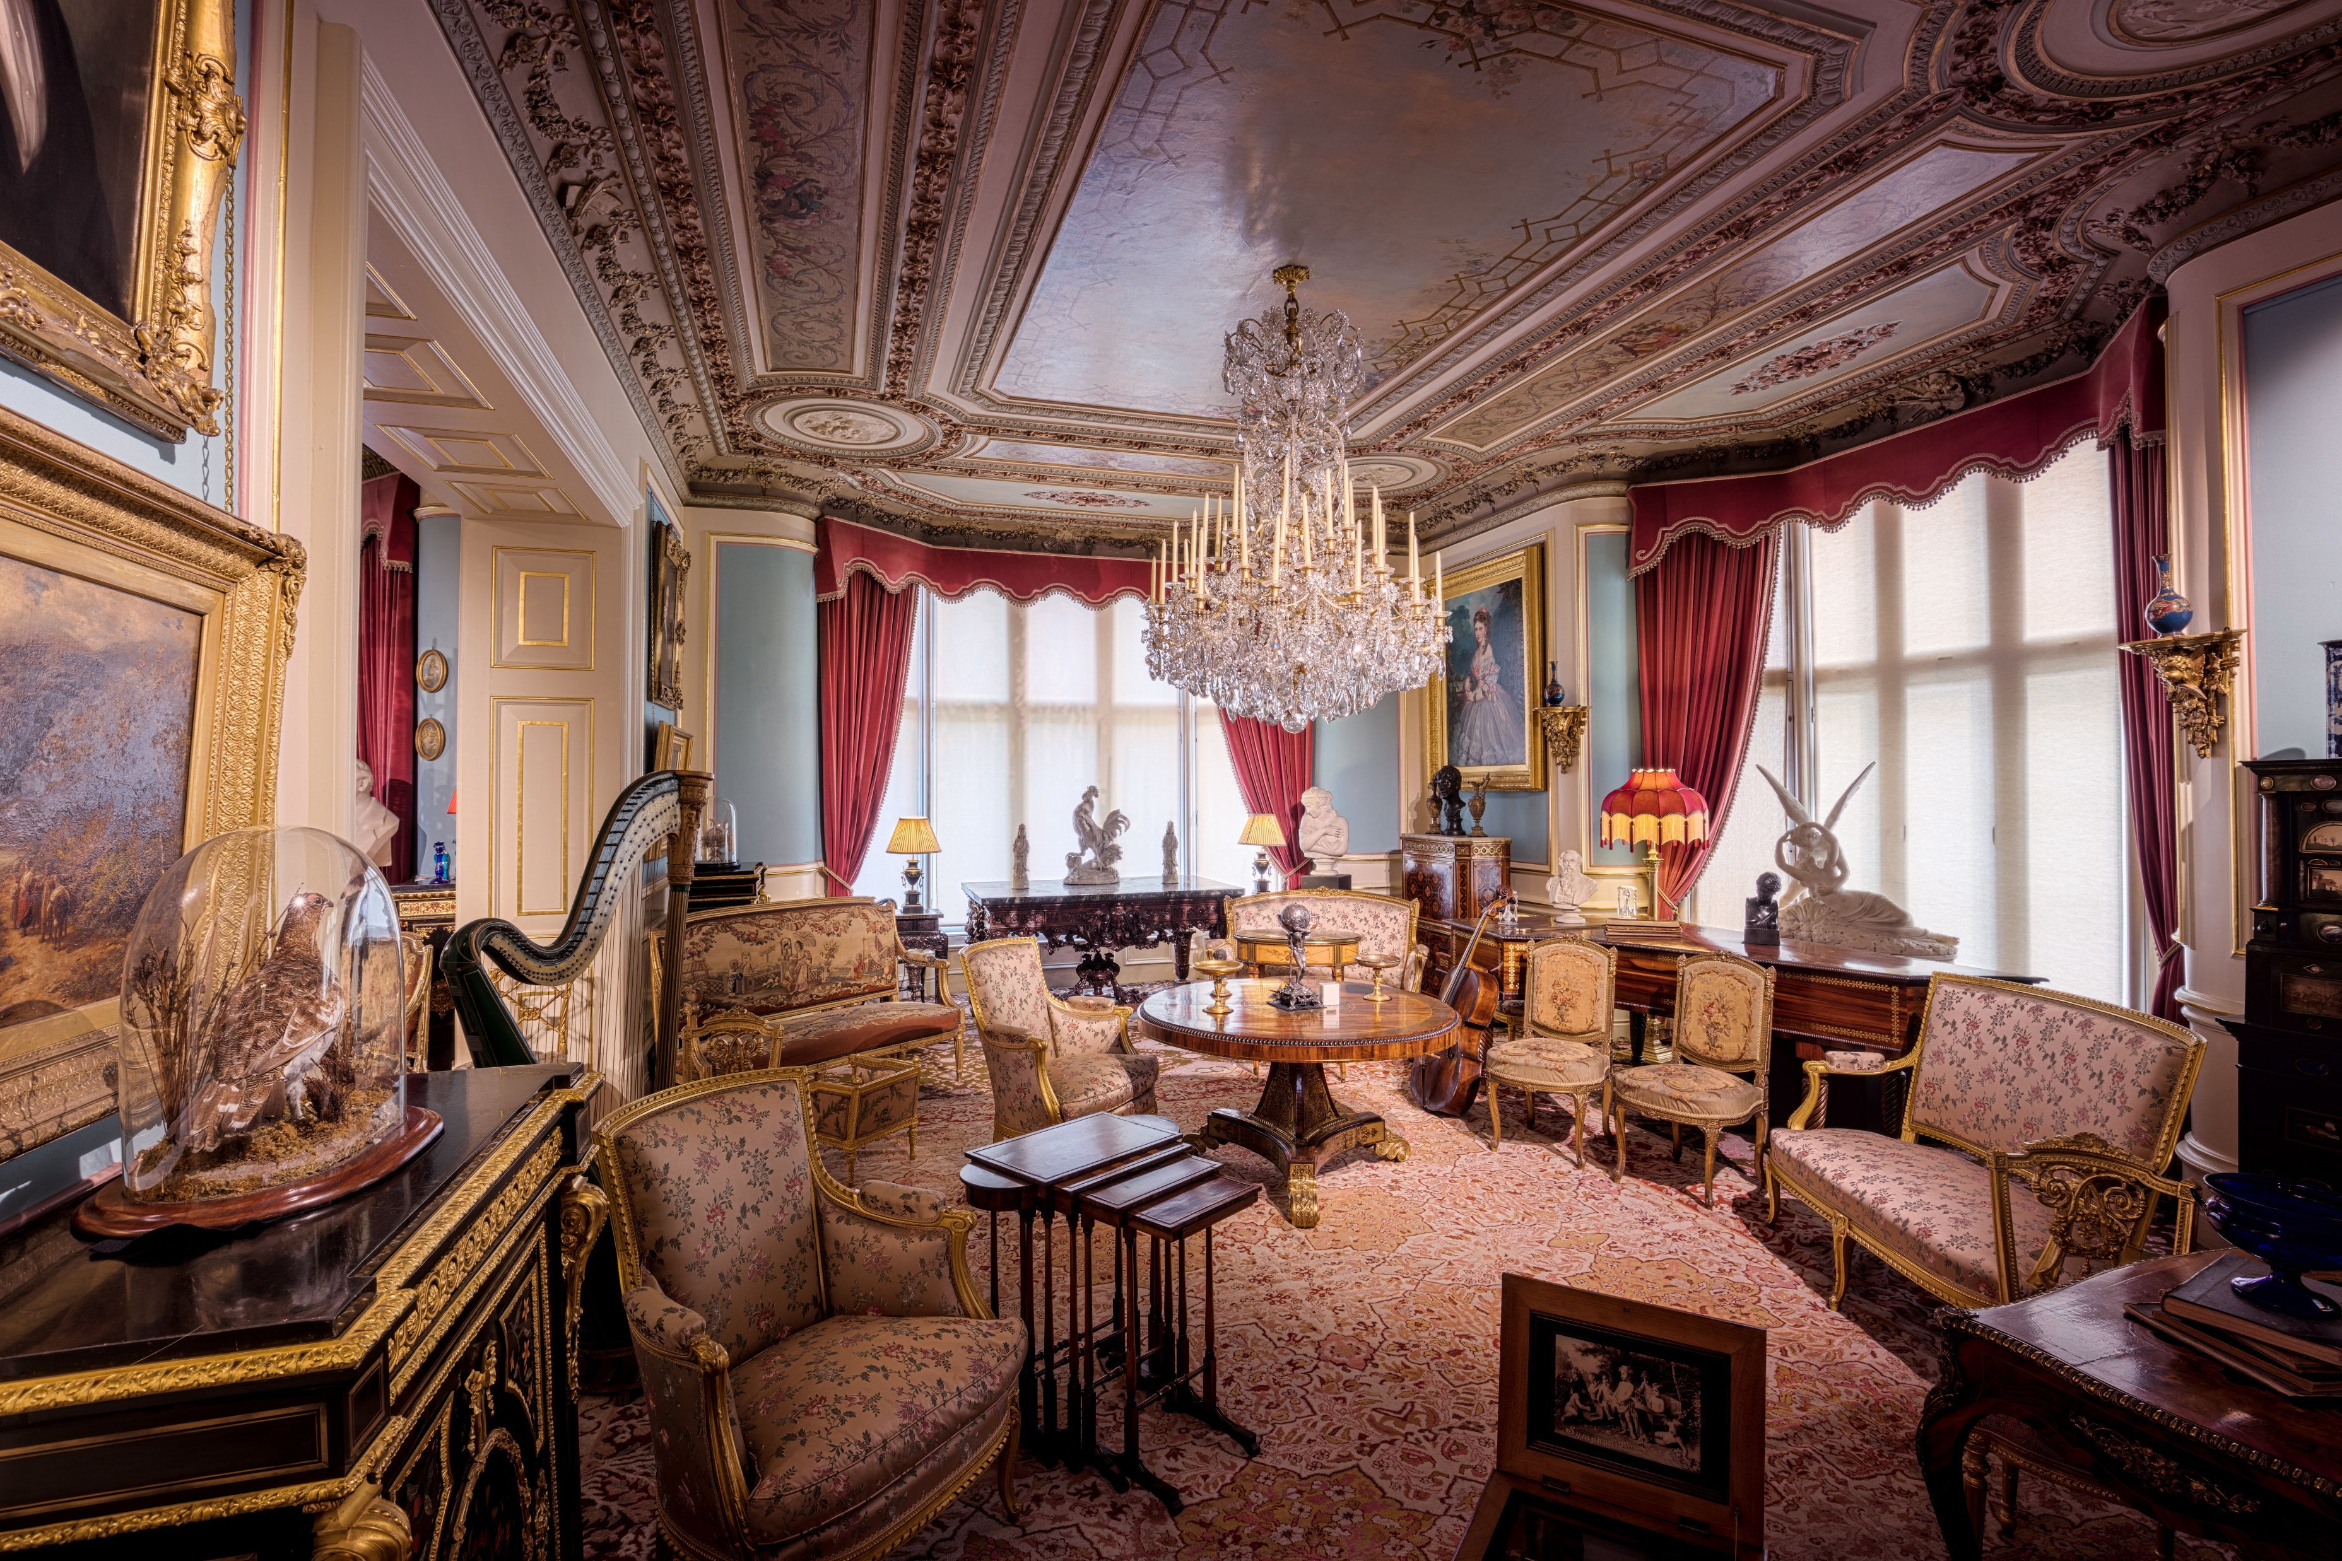
两个老头密谋打赌的场景 找不到合适的☹

Slide 7
Act 1. Scene 2
Last scene ending with:
Mr. G: (frown) A bet? Oh gentlemen, I am astonished at your purpose, and that you should call it ... a scrap of paper. Allow me to draw your attention to the text. (reads, slowly and carefully) I promise to pay the bearer on demand the sum of one million pounds.
(R.M. and O.M. looked at each other, smiled again and nodded without saying a word.)

Slide 8
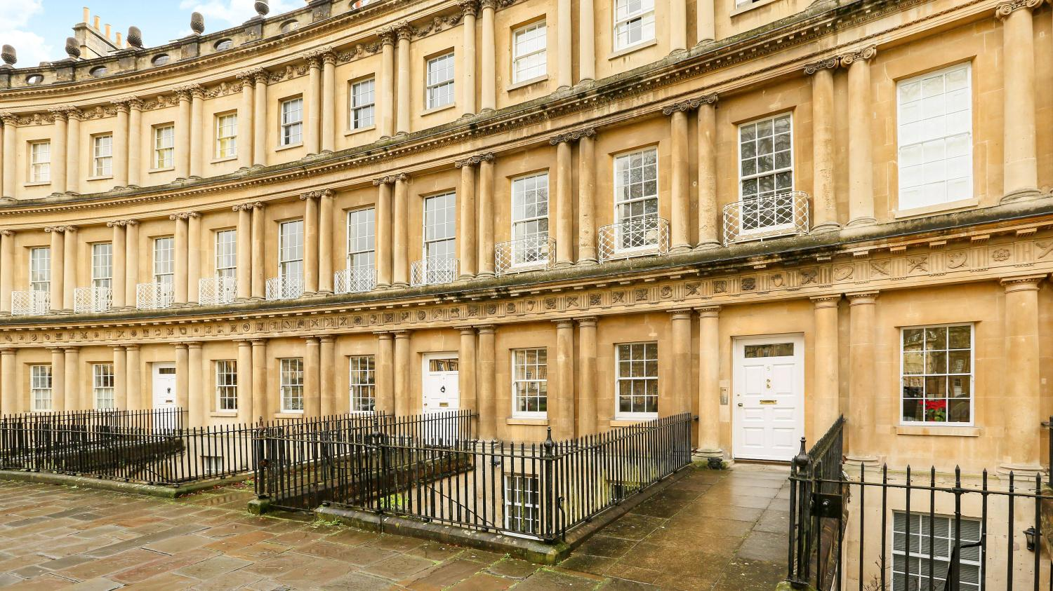

Slide 9
Last background ending with:
O.M.: Through the front door, on your left.
H.A.: Thanks.
M.b.: Good morning, sir. Will you please come in? Permit me to lead the way, sir. (M.b. with H.A.
into Montpelier's room)

Slide 10

两个老头密谋打赌的场景 找不到合适的☹

Slide 12
Act 2
Last act ending with:
(O.M. and R.M. standing up too)
R.M.: Mr. Adams! (pause for a while, then with a smile) Wish you good luck.
H.A.: (slightly sighing) Thank you, sir. Goodbye.

Slide 13
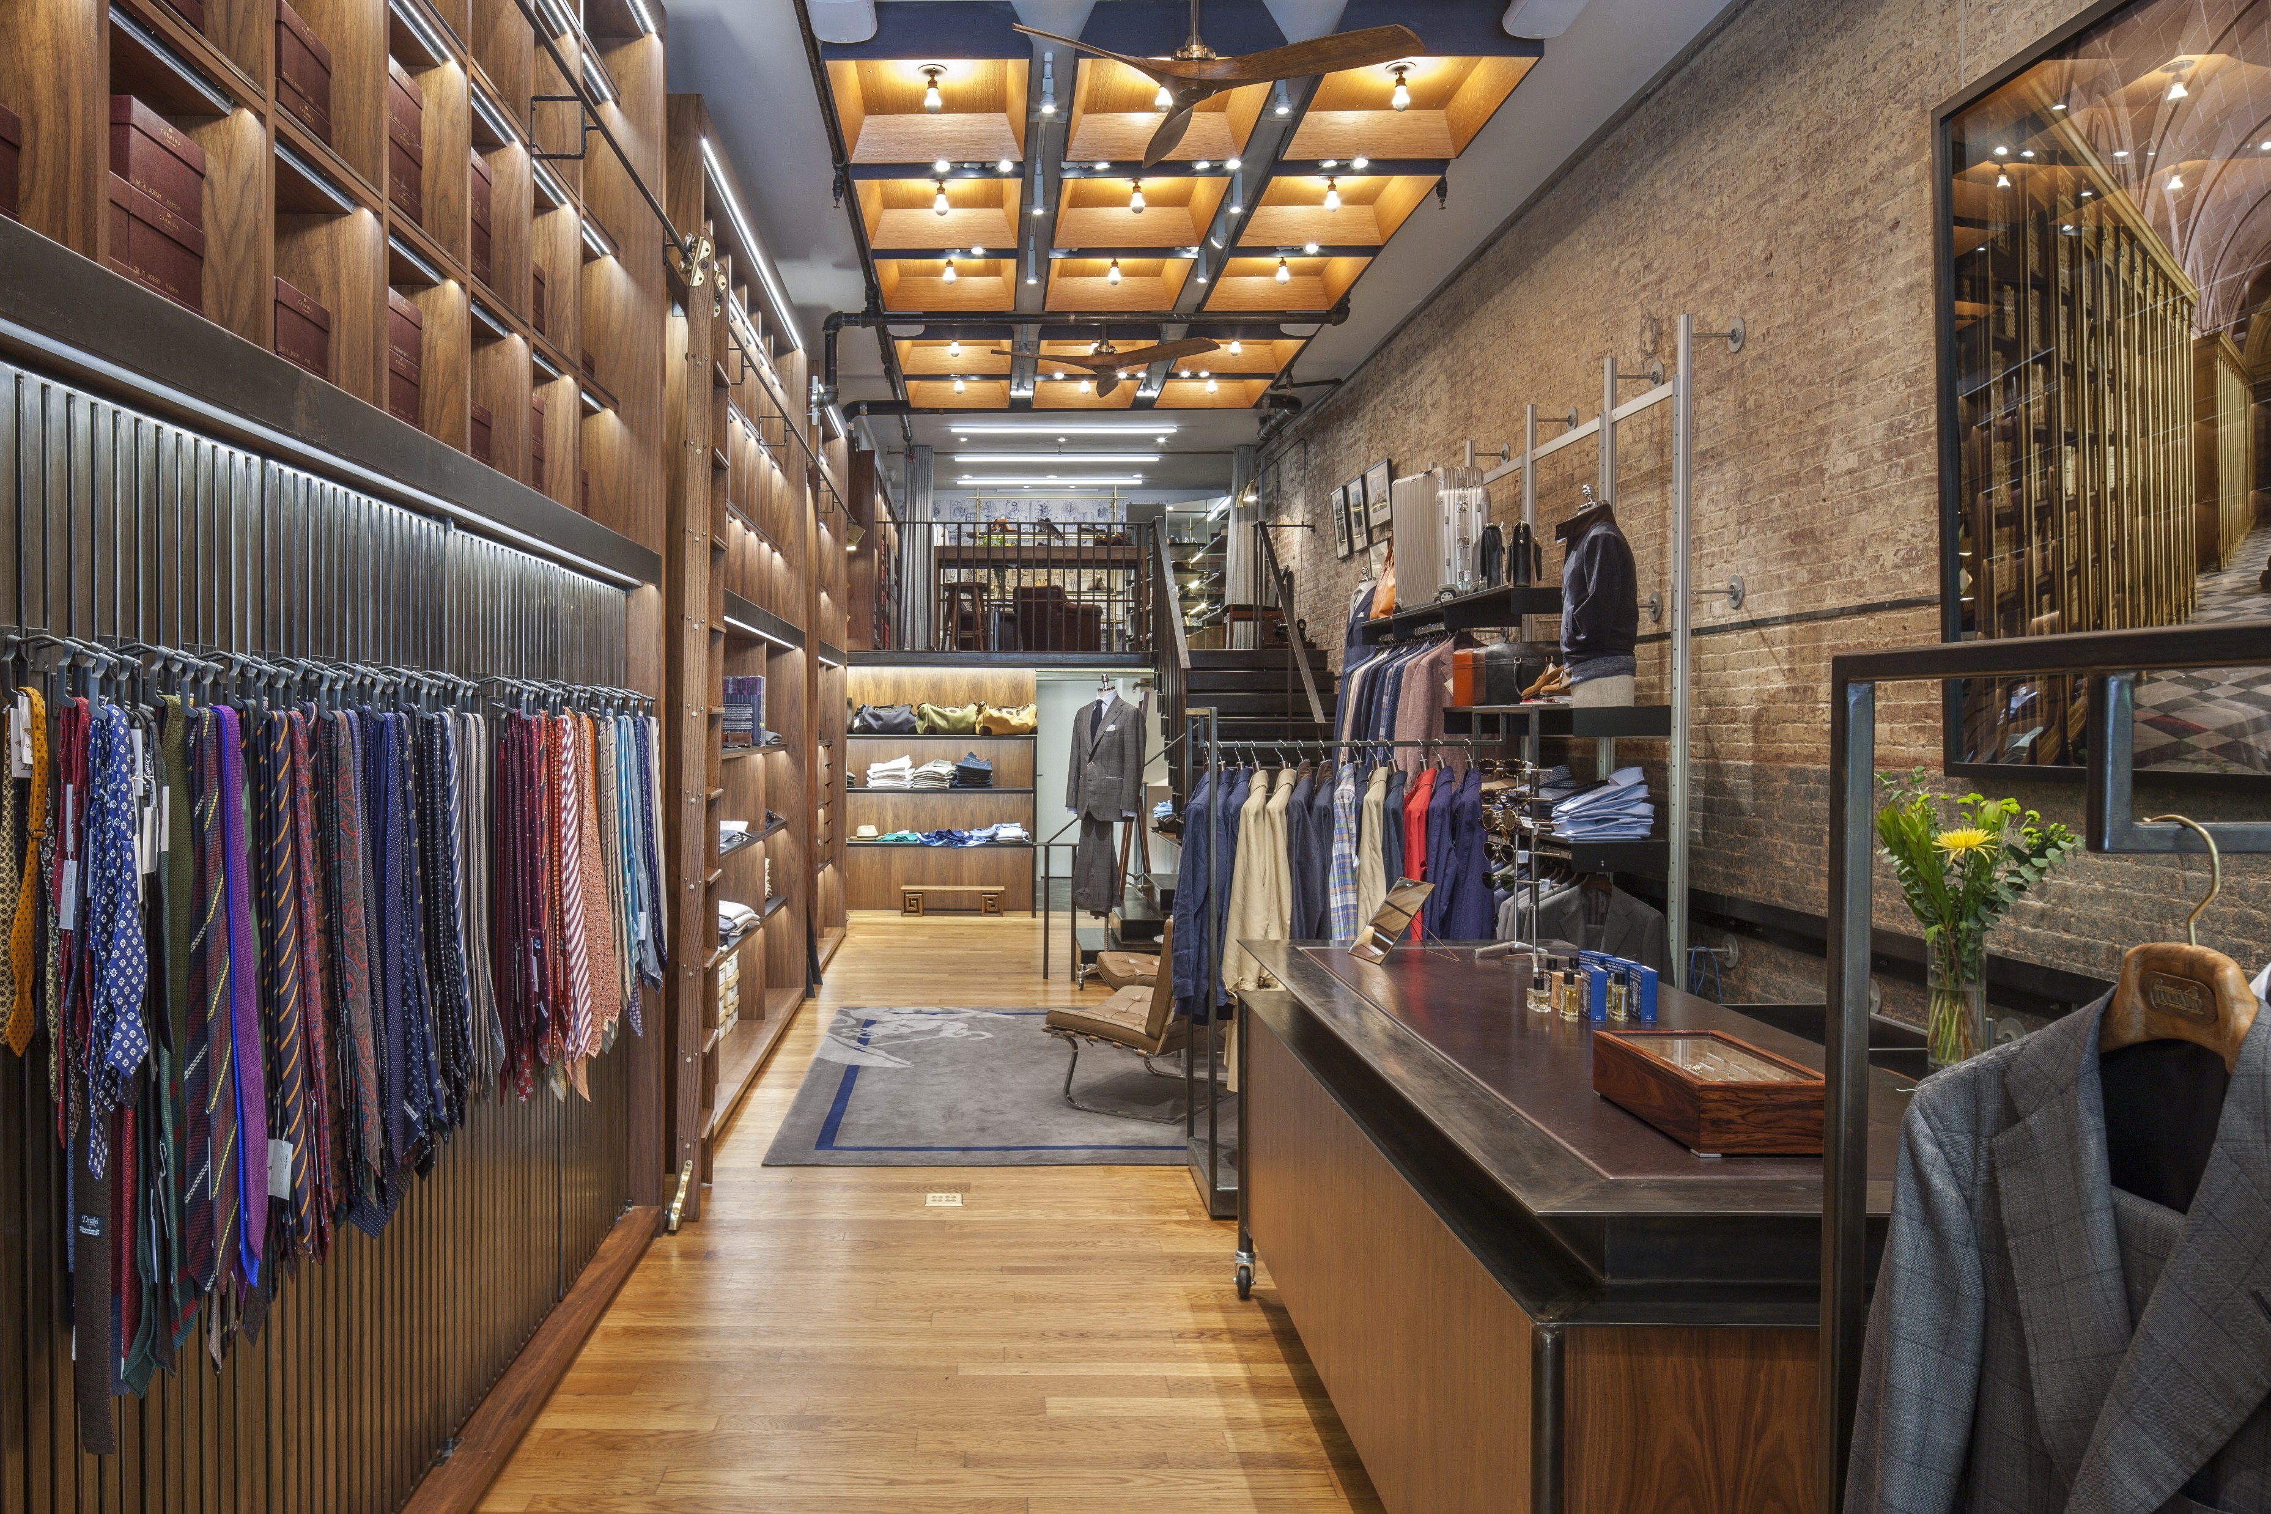
Abandoned

Slide 14
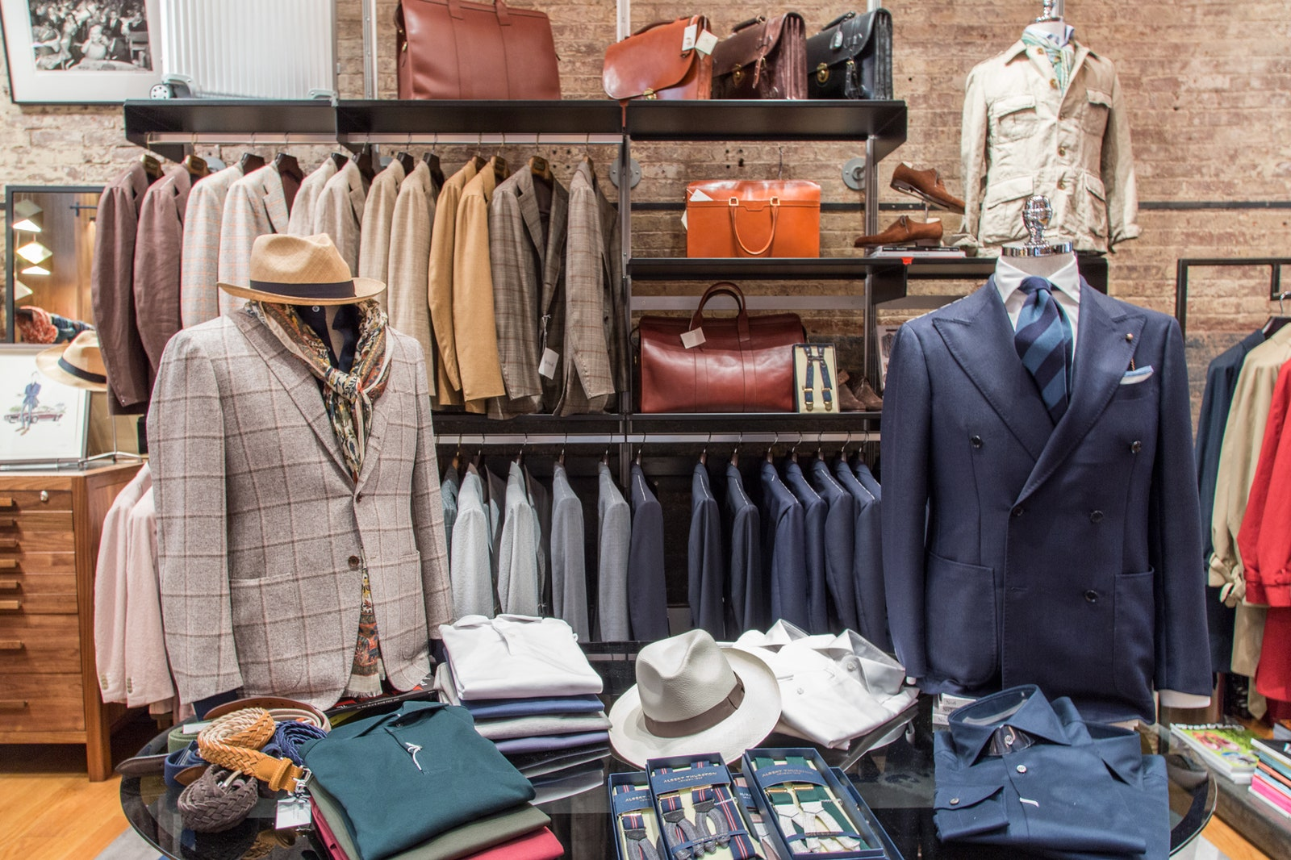
Abandoned

Slide 15
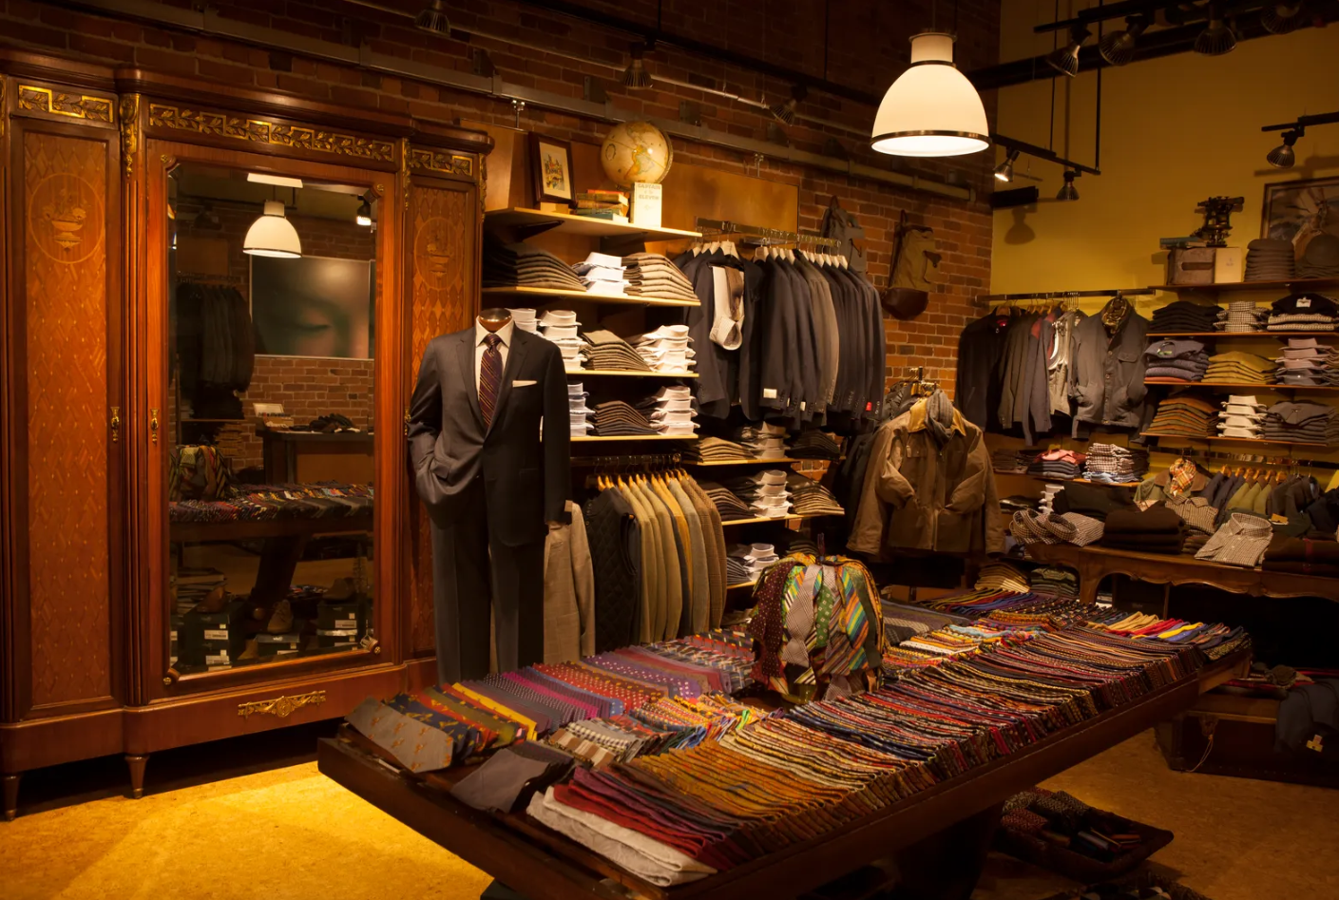

Slide 16
Last background ending with:
Hey you stupid donkey! Get Jack, Arthur and William. Be quick! (C.S.S.1 running off the stage, suddenly very very sycophantly and politely) Allow me sir. Er... This way, sir.

Slide 17
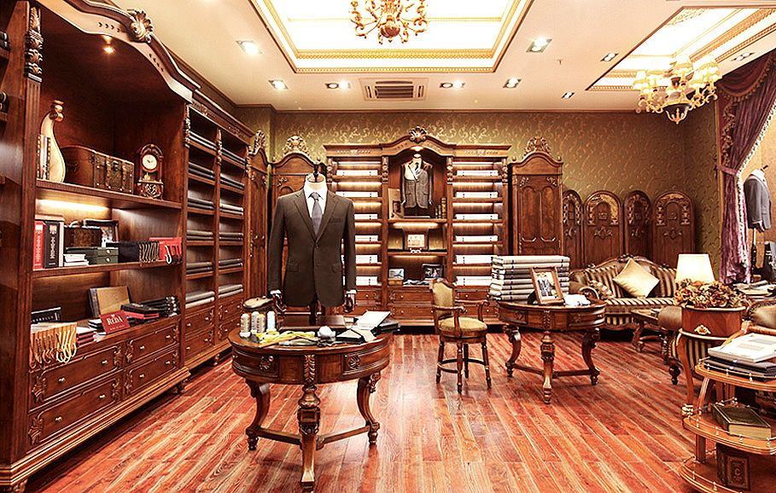

Slide 19
Act 3
Last act ending with:
H.A.: Bumbles?
C.S.M: The very place, quiet, modest and discretion itself. (with a very very sycophantic smile) Luckily for you I have a relative on the management. Leave it to me.

Slide 20
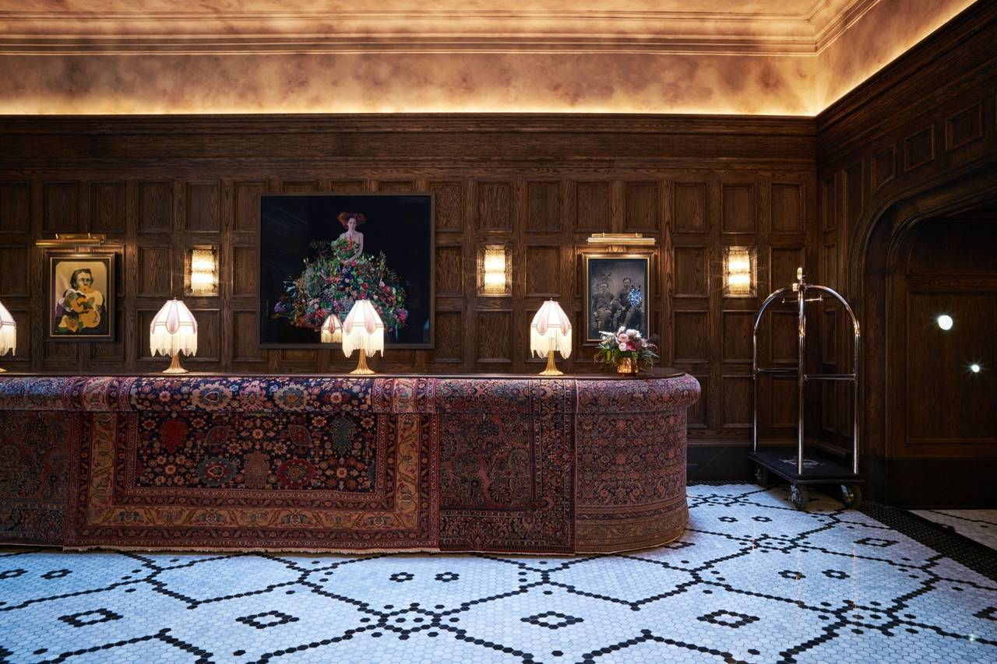

Slide 22
Act 4. Scene 1
Last act ending with:
Rock: (Holds out his hand)
H.A.: (Shakes hands with Rock) (To Rock, proudly) For the next month, I’m H.A., the American Millionaire.

Slide 23
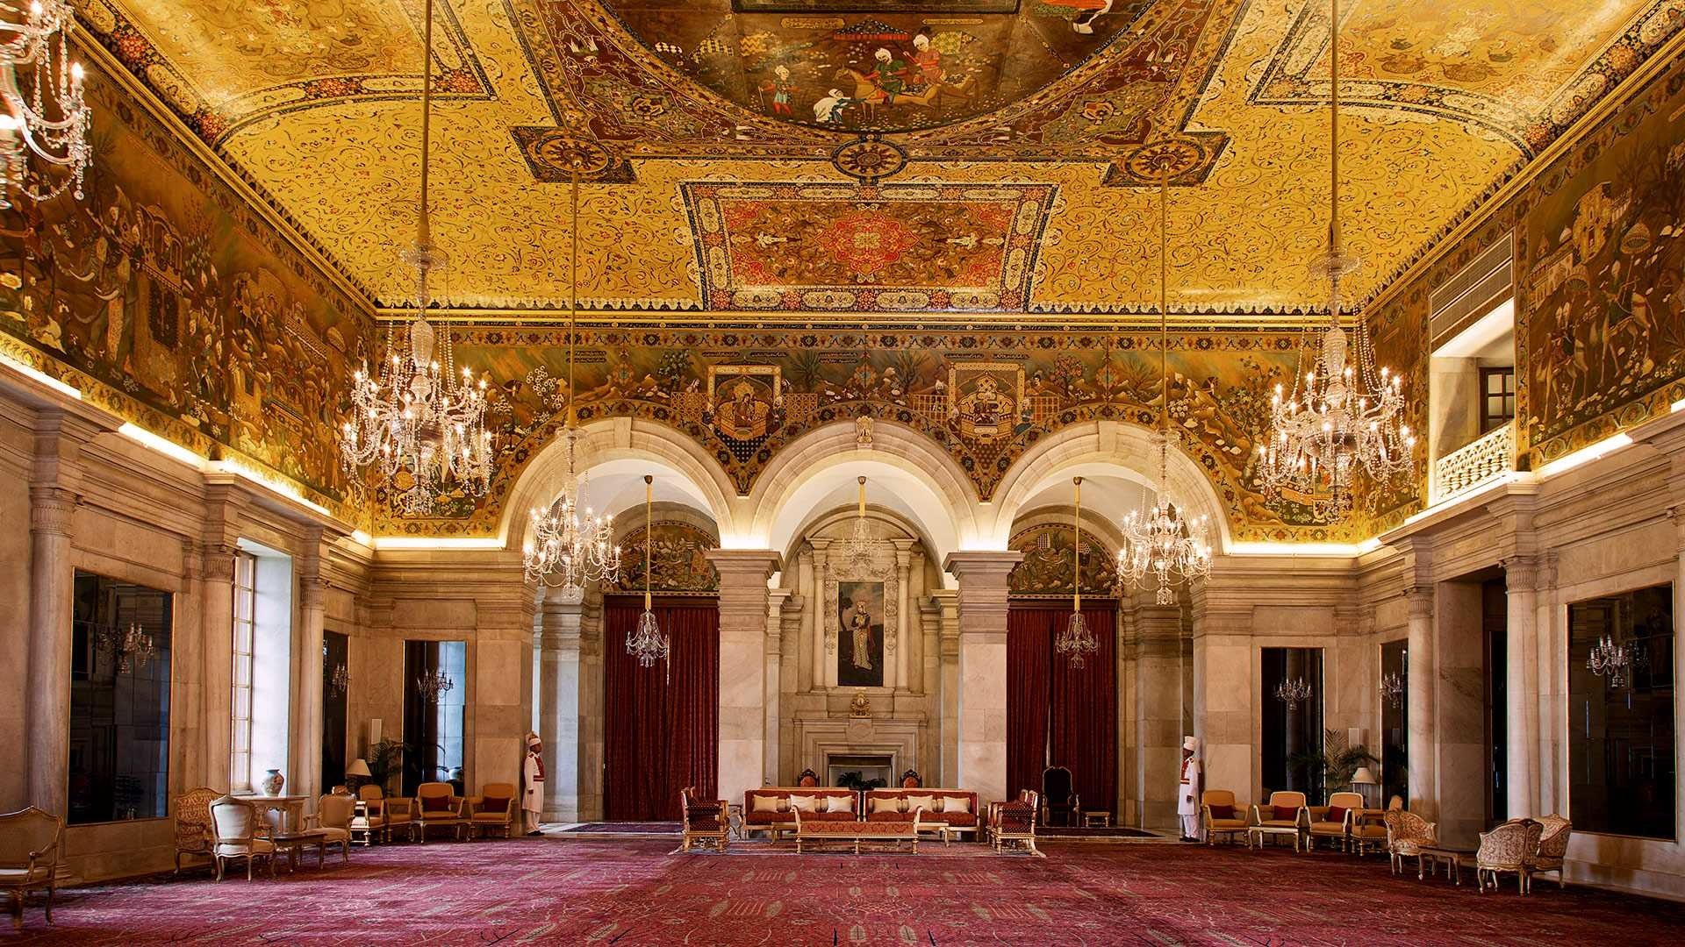

Slide 25
Act 4. Scene 2
Last scene ending with:
Guest 3: Now, Mr. Adams, I want you to make the acquaintance of Sir William Collins...
(H.A. and Guest 3 off the stage)
Guest 1: A man of character!
Guest 2: We must invite him to lunch!

Slide 26

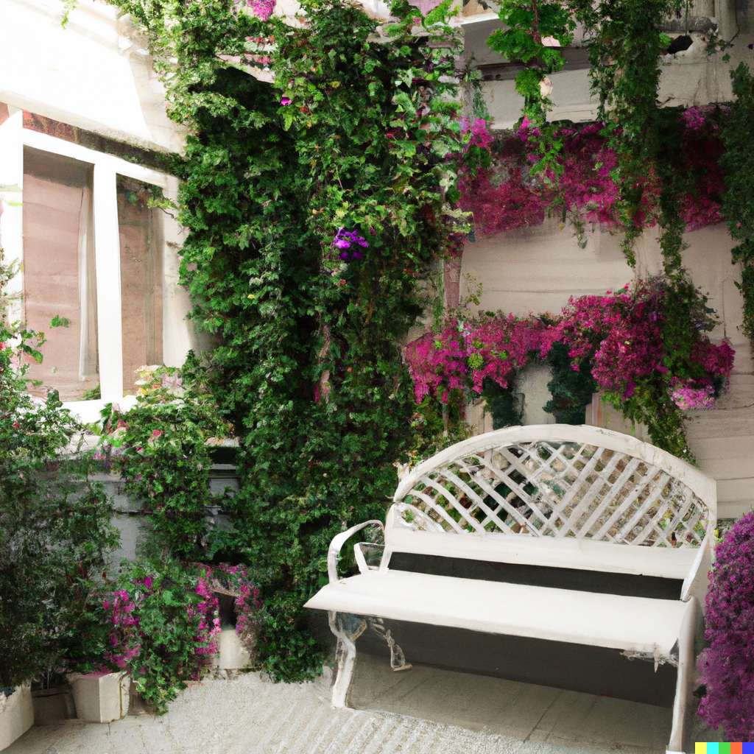
NB: 此处图片均由 DALL·E 绘制。

Slide 28
Act 5
Last act ending with:
(Henry and P.L. off the stage.)
N.: Henry is invited to the Home for Motherless Babies. After taking a look at the babies, he is taken to a charity auction. He doesn't want to donate much, but is urged by the audience to donate five thousand pounds.

Slide 29
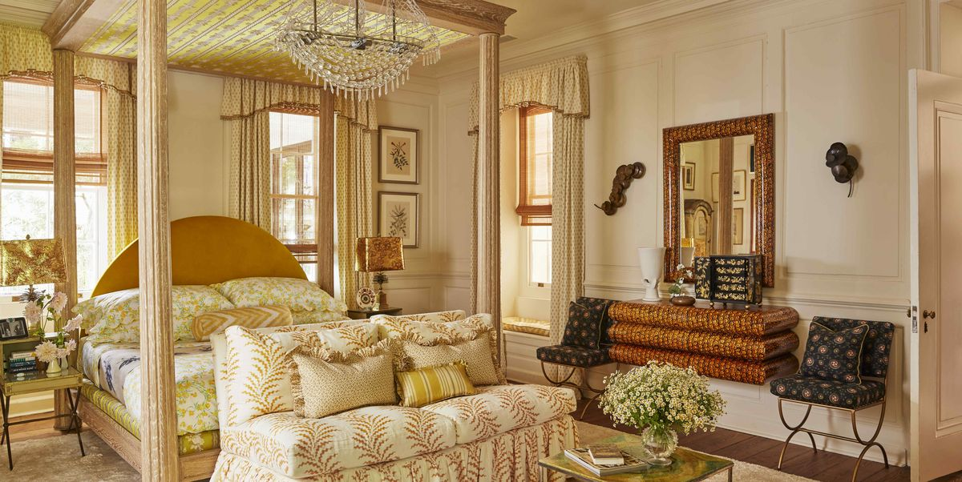

Slide 31
Act 6
Last act ending with:
H.A.: (Cheerfully) Rock! We're not going. (Tapping Rock on the shoulder) Things always look bad at night. But in the morning the sun is shining and the birds are singing. We can't throw in the cards like this when the game is only halfway through.

Slide 32
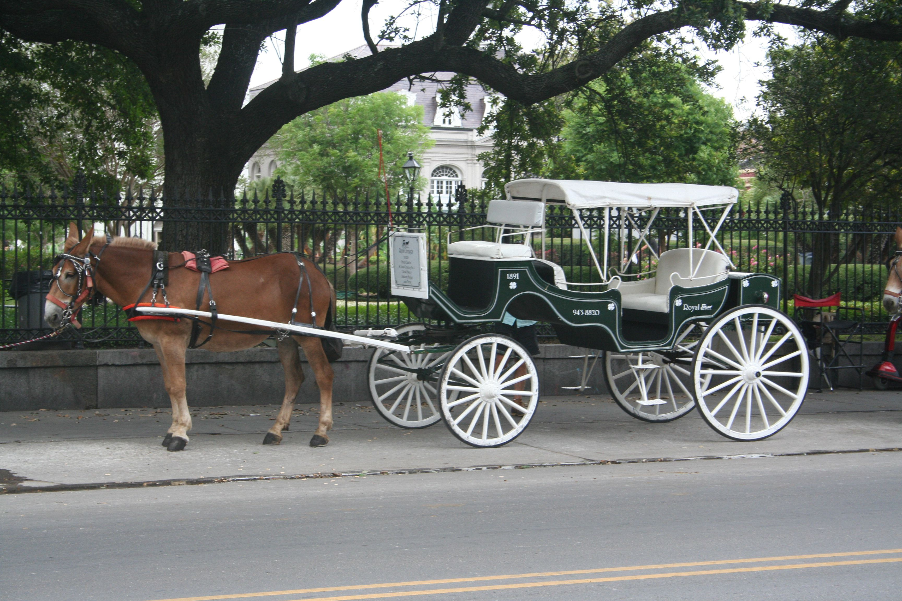

Slide 34
Act 7. Scene 1
Last act ending with:
Mr.H.: (Excitedly) I may use your name! Your name - think of it! Man, they'll flock in droves, these rich Londoners; they'll fight for that stock! I'm a made man, I'm a made man forever, and I'll never forget you as long as I live!

Slide 37
Act 7. Scene 2
NB: 这里的图片仍有提升空间; 图片展现的内容最好稍微弄得奢华一点, 但风格不能是现代的。
Last scene ending with:
M.bum: He's a public figure, your grace, of considerable standing.
D.F.: Stuff and nonsense! (irritated, angrily leaves the counter without even picking up the bank notes)

Slide 38
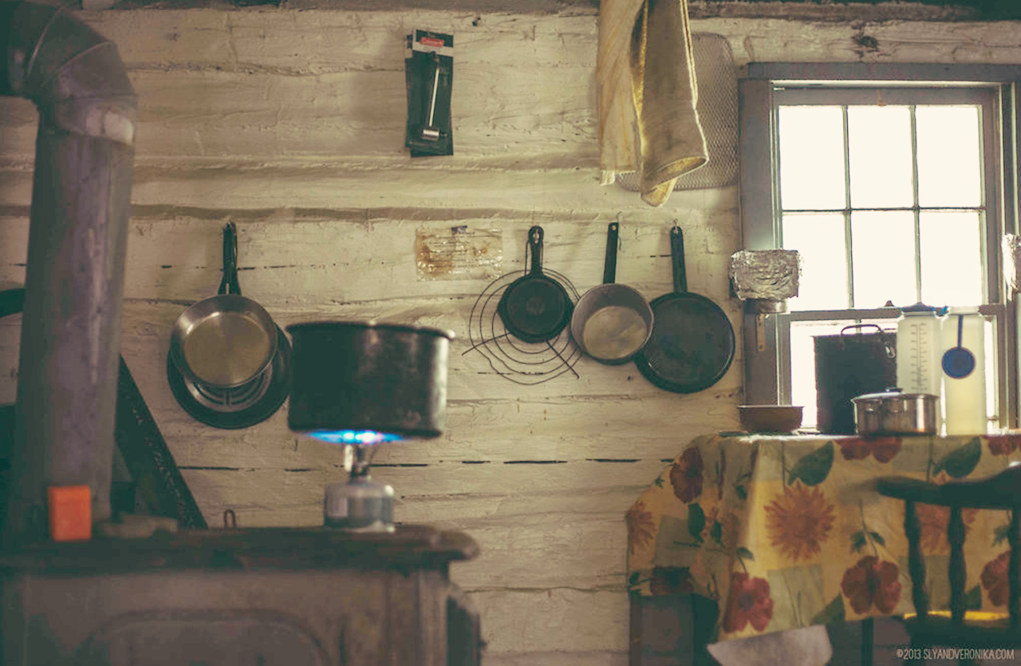

Slide 40
Act 7. Scene 3
Last scene ending with:
N.: (Renie.Bum acts correspondingly) And so Renie gracefully strode into Henry's suite with the subterfuge of a cleanup. Smartly lurking behind Henry's views, she adeptly took the cheque out of Henry's clothes in the wardrobe and hid it right beneath the carpet - just like a skillful prowler. Poor Rock didn't even took notice of Renie's presence.
(Renie.Bum returned to Duke of Frognal who feigned a praise and left)

Slide 41
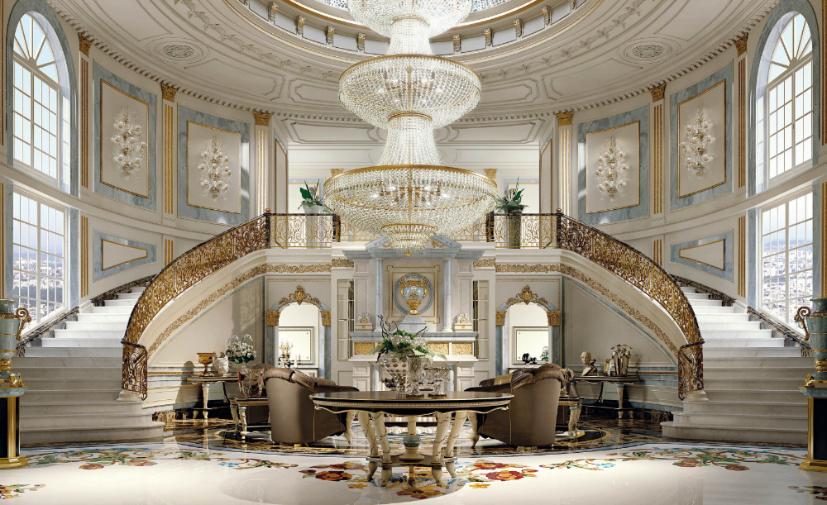

Slide 43
Act 7. Scene 4
背景要统一一下
Last scene ending with:
Duchess.C.: No, my dear. If you were an ordinary girl it wouldn't matter. But, alas, we are not an ordinary family.
(Aunt locks the door, with P.L. desperately pounding from inside)
P.L. Let me out!

Slide 44
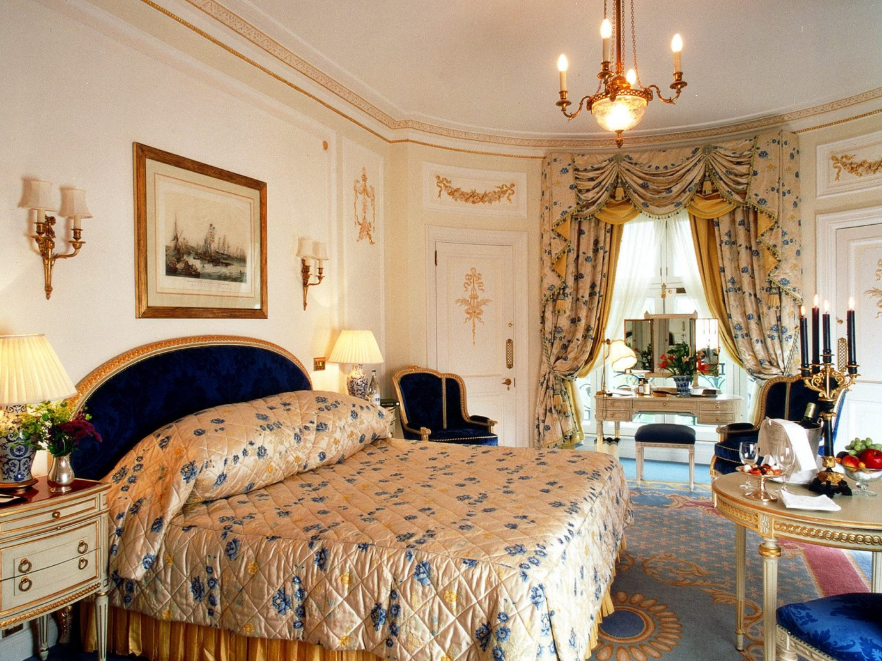

Slide 46
Act 7. Scene 5
Last scene ending with:
H.A.: (pensive, but then delighted when he reminisced of Hastings' shares) I'll settle my accounts in full this aternoon. It so happens that my real fortune is tied up in mining ... gold mining. Well, good morning, gentlemen. You're a fascinating species. Sometime you must take a good look at yourselves (hurry out the doorway, arrogant) ... under a microscope.

Slide 47
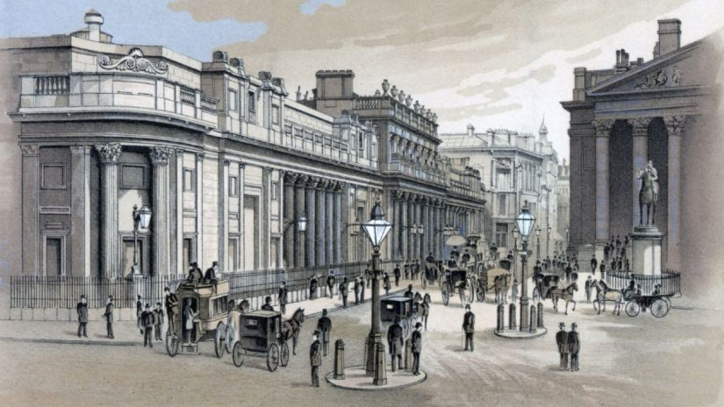
London Stock Exchange

Slide 49
Act 8
Last act ending with:
H.A.: (pensive, but then delighted when he reminisced of Hastings' shares) I'll settle my accounts in full this afternoon. It so happens that my real fortune is tied up in mining ... gold mining. Well, good morning, gentlemen. You're a fascinating species. Sometime you must take a good look at yourselves (hurry out the doorway, arrogant) ... under a microscope.

Slide 52
Act 9
Last act ending with:
N.: Remember our Portia? Well, as soon as the million pound note was found, the shares price of Good Hope mines peaked again, and Portia's aunt was quite content to receive the five thousand pounds that Henry has promised her. Busy counting money and boasting about her blueprint for the money, Portia's aunt definitely Portia to continue her relationship with Henry. But Portia never cared about those filthy bits of paper - she just badly wanted to see Henry.
(P.L. was escorted into the hall)
P.L. Henry! Oh, Henry.
(Without further words, the two hugged and kissed)

Slide 53
两个老头密谋打赌的场景 找不到合适的☹

